Slide 1
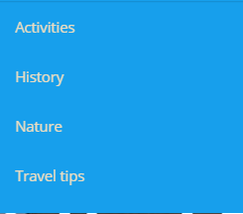
Contact Us /contact/
Blog /blog/
About Us Abre plegable
Why Andando - /about-us/
Responsible Travel /about-us/responsable-Travel/
Andando in the Media /about-us/media/
Angereyer Cruises /about-/angermeyer-cruises/

Slide 2
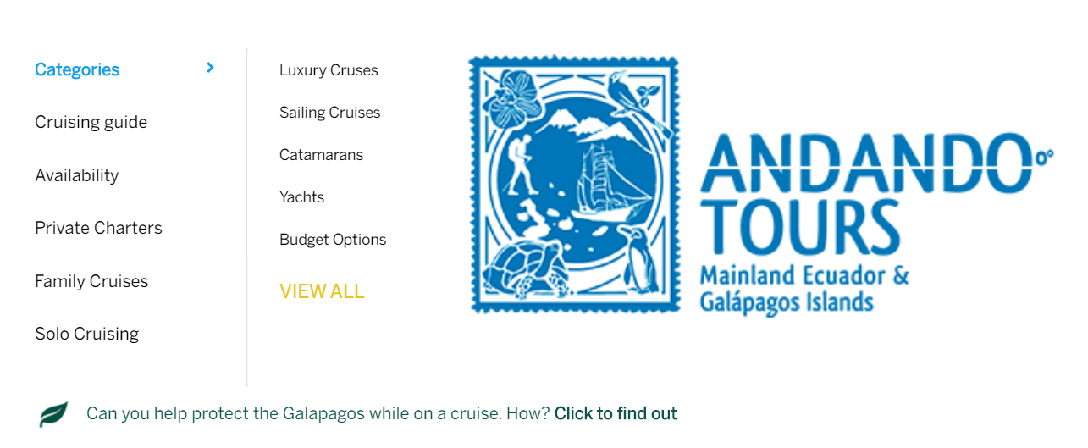
ALL OUR CRUISES /galapagos-cruises/
Categories despliega opciones
/galapagos-luxury-cruise/
/sailing-cruises/
/galapagos-cruises/galapagos-catamarans/
/galapagos-cruises/galapagos-yachts/
/cruises/budget/
Yacht Charters /cruises/yacht-charters/
Family Cruises/cruises/family/
Solo Cruises/blog/cruises-for-single-adventurers/
Availability /cruises/availability/
Help with your trip to conservation projects in the archipelago. How? Click to find out. /about-us/responsible-travel/

Slide 3
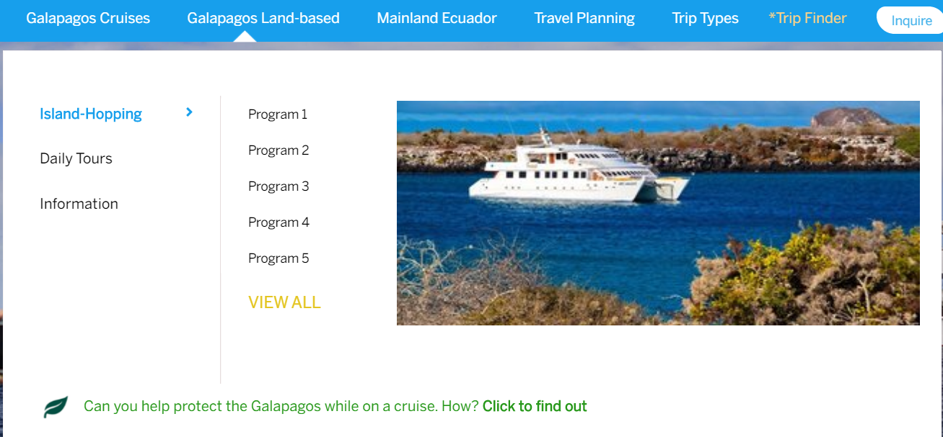
Daily Tours despliega elementos
From Isabela /tours/isabela/
From Santa Cruz /tours/santa-cruz/
From San Cristobal /tours/san-cristobal/
VIEW ALL /galapagos-daily-tours/
Island-Hopping despliega elementos
Best of Galapagos /tours/island-hopping/best-of-galapagos/
Galapagos Multisport /tours/island-hopping/galapagos-multisport/
Galapagos Intensive /tours/island-hopping/galapagos-intensive/
Santa Cruz Express /tours/island-hopping/santa-cruz-express/
San Cristobal Express /tours/island-hopping/san-cristobal-express/
VIEW ALL /tours/island-hopping/
Information despliega elementos
I.Hopping vs Cruises /blog/best-way-to-travel-galapagos/
Galapagos Travel Guide abre pop-up de formulario
Esto no va en esta sección

Slide 4
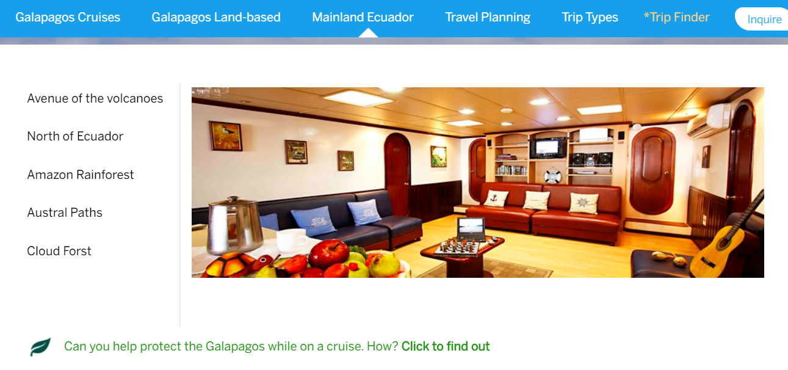
Avenue of the Volcanoes /ecuador-itineraries/avenue-of-volcanoes/
Amazon Rainforest /ecuador-itineraries/amazon-tours-ecuador/
North of Ecuador /ecuador-itineraries/magical-north/
Austral Paths /ecuador-itineraries/austral-paths/
Cloud Forest /ecuador-itineraries/cloud-forest/
VIEW ALL /ecuador-itineraries/
Support different communities, artisans, and conservations projects around mainland Ecuador with your trip. View More. /about-us/responsible-travel/

Slide 5
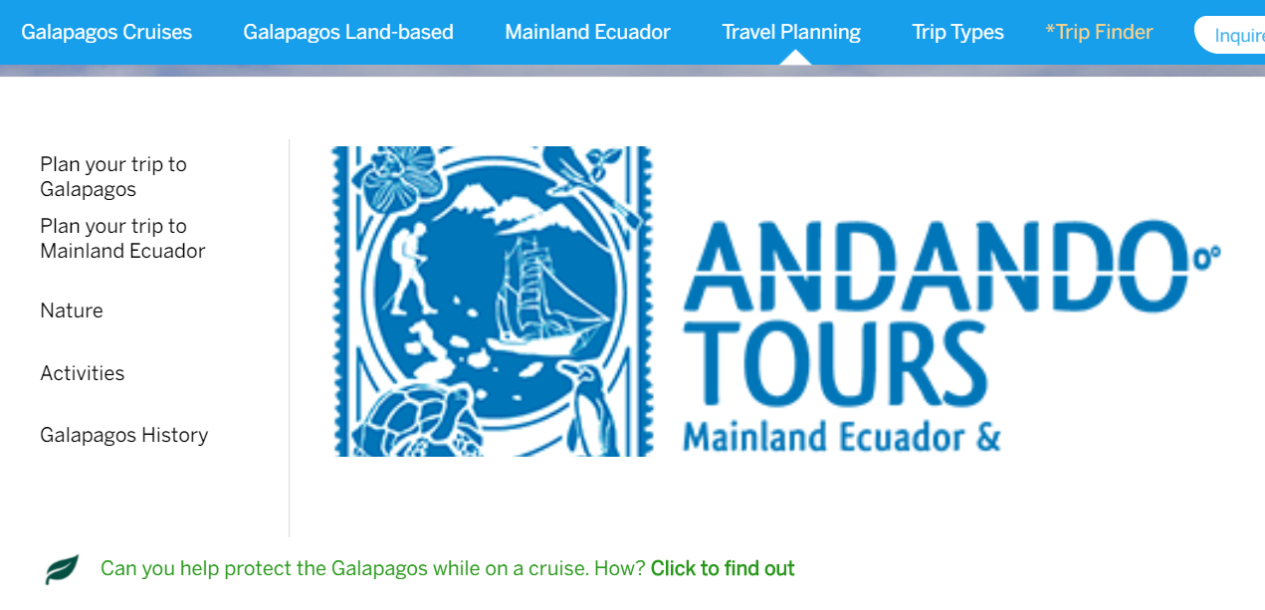
Plan your Galapagos trip
What to do /plan-your-trip/galapagos-travel-ideas/
Map and Visitor Sites /ecuador-itineraries/amazon-tours-ecuador/
Considerations /plan-your-trip/galapagos-travel-recommendations/
Choose your itinerary/plan-your-trip/choosing-itinerary/
Cost of Travel /plan-your-trip/galapagos-travel-information/costs/
VIEW ALL /plan-your-trip/galapagos-travel-information/
Plan your trip to Mainland Ecuador
What to do /plan-your-trip/ecuador-travel-ideas/
Considerations /plan-your-trip/ecuador-travel-recommendations/
National Parks of Ecuador /plan-your-trip/mainland-ecuador/national-Parks/
Insurance/plan-your-trip/galapagos-travel-map/
VIEW ALL /plan-your-trip/mainland-ecuador/
Your trip will support social development and the conservation of the natural environment . View More. /about-us/responsible-travel/
Galapagos Nature
Galapagos National Park Rules /plan-your-trip/galapagos-nature/national-park/
Wildlife Calendar /plan-your-trip/galapagos-nature/wildlife-calendar/
Birdwatching /plan-your-trip/galapagos-nature/birdwatching/
Marine Reserve/plan-your-trip/galapagos-nature/marine-reserve/
Landscapes /plan-your-trip/galapagos-nature/landscapes/
Activities /plan-your-trip/galapagos-activities/
History /plan-your-trip/history/

Slide 6
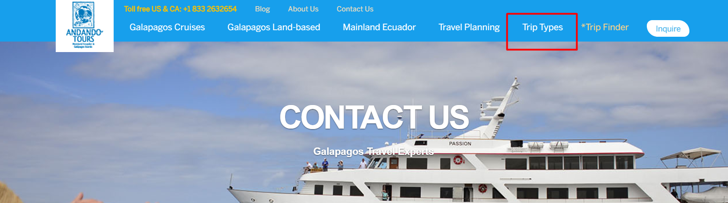
Honeymoons /trip-types/honeymoons/
Family Vacations /trip-types/family-vacations/
Gay Tours /trip-types/gay-tours/
Solo Travel /trip-types/solo-travelers/
Honeymoons /tours/
Abre formulario tailor-made

